Slide 1

Landsphere
Real Estate Web Portal
Developed by Shreyansh Srivastava/ Softpro India

Slide 2

Introduction: Revolutionizing Real Estate
Project Overview
Problem
Landsphere streamlines property bookings online seamlessly.
Traditional real estate processes are inefficient and opaque.
Solution
Centralized platform to buy, sell easily.

Slide 3
Tech Stack: Powering Landsphere
Backend
Frontend
Database
Python, Django
HTML5, CSS3
SQLite3 (Development)
Django Framework
JavaScript
Bootstrap

Slide 4
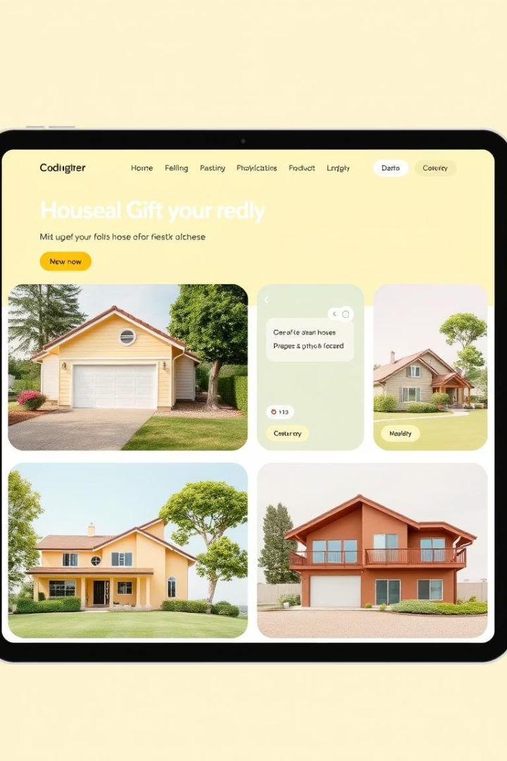
Key Features: User-Centric Design
Property Listings
Details, filters by price, location, type, and images.
Interactive Map
Geolocation with nearby amenities using Leaflet.js integration.
User Accounts
Secure login, role-based access for buyers, sellers, and admins.
Contact Forms
Direct inquiries to property owners for fast communication.

Slide 5
Django Architecture: Scalable and Secure
Architecture
Database
Security
Modular Design
Model-View-Template (MVT) for clear separation of concerns.
Django ORM for efficient and secure database handling.
Built-in protections against CSRF and XSS attacks.
Scalable structure for future feature expansion.

Slide 6




RESTful API: Seamless Data Exchange
Django Framework
Built-in Auth
Access property data and user authentication.
Powerful framework for building Web Applications.
Integration Ready
Supports connections with external services and apps.

Slide 7
Data Management: Efficient and Organized
Development Database
Production Database
Data Models
Validation
Structures for properties, user profiles, and transactions.
Strict checks maintain data integrity and accuracy.
SQLite3 offers easy setup and rapid prototyping.
Sqlite3 ensures scalability, security, and reliability.

Slide 8
Deployment: Ready for Launch
Platform
Web Server
Application Server
AWS EC2 instance powers the hosting environment.
Nginx ensures efficient request handling and caching.
Gunicorn runs the Django application in production.
Database
Automation
AWS RDS hosts PostgreSQL for reliable storage.
CI/CD pipeline automates testing and deployment.

Slide 9
Market Analysis: Untapped Potential
Market Size
Target Audience
Competitive Edge
Growth Strategy
$8 Billion online real estate market in 2023.
Millennials and Gen Z seeking digital convenience.
User-friendly UI with robust features outperforms rivals.
Strategic partnerships and focused marketing campaigns.

Slide 10

Conclusion: Your Real Estate Solution
Innovative Platform
Efficient Bookings
Landsphere offers a streamlined online real estate experience.
Easy buying, selling with data-driven insights.
Call to Action
Visit Landsphere today and transform your property journey.

